Slide 1
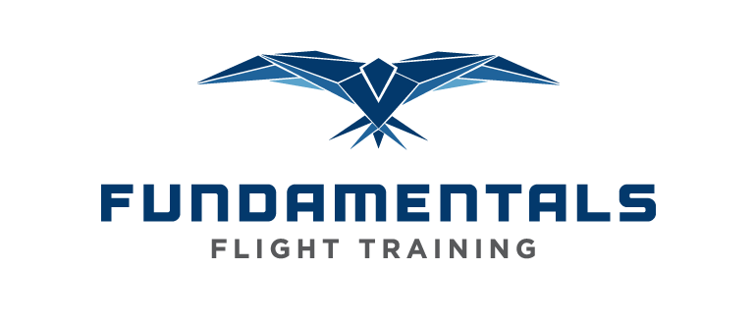
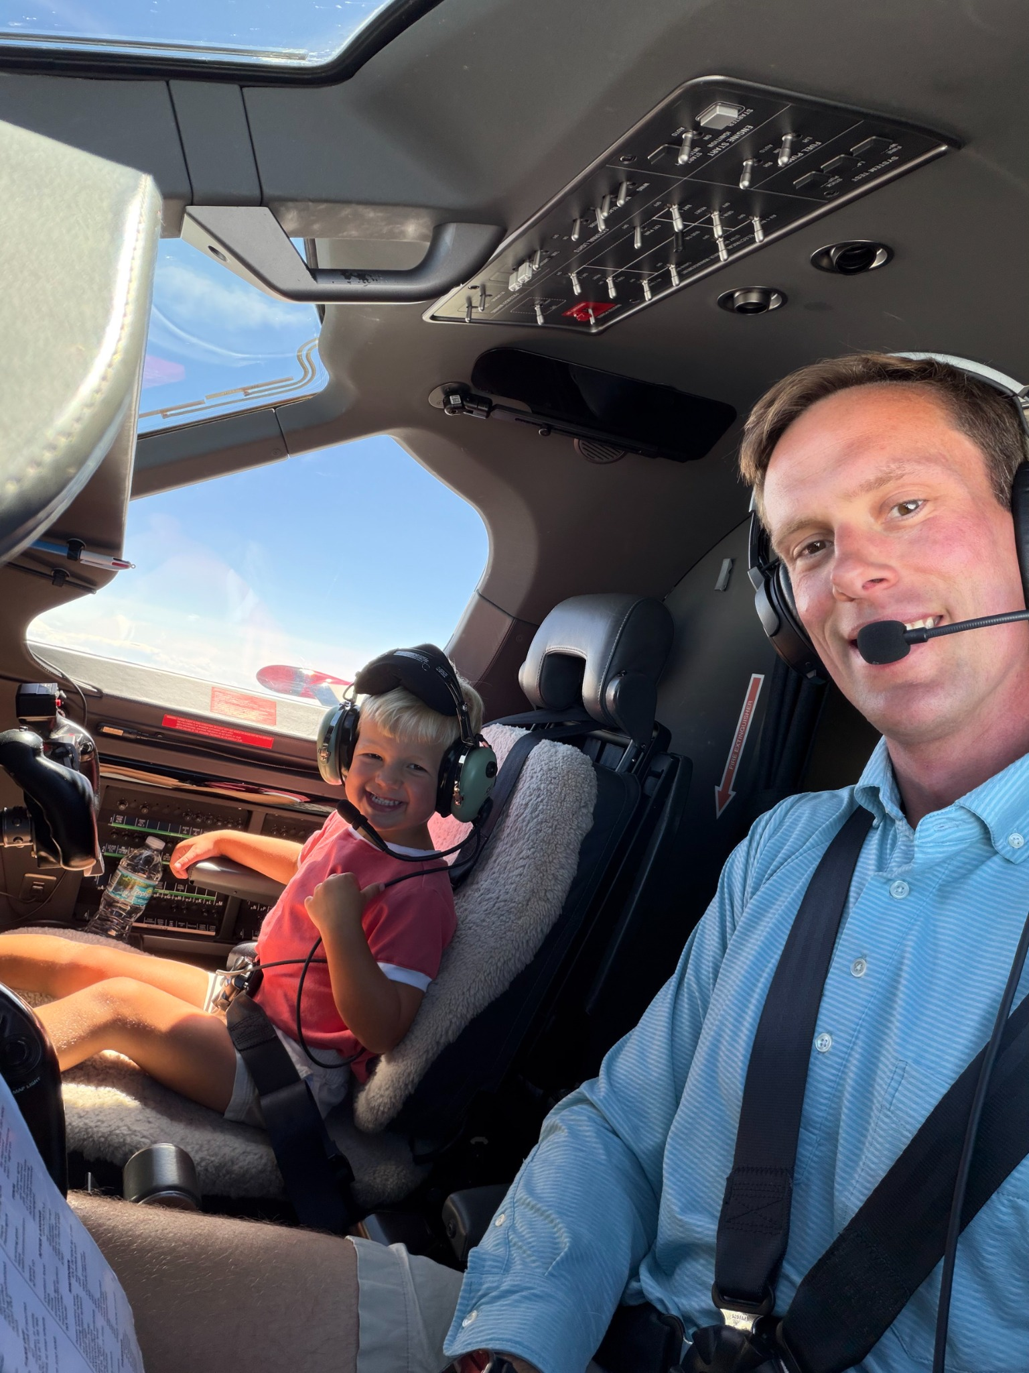
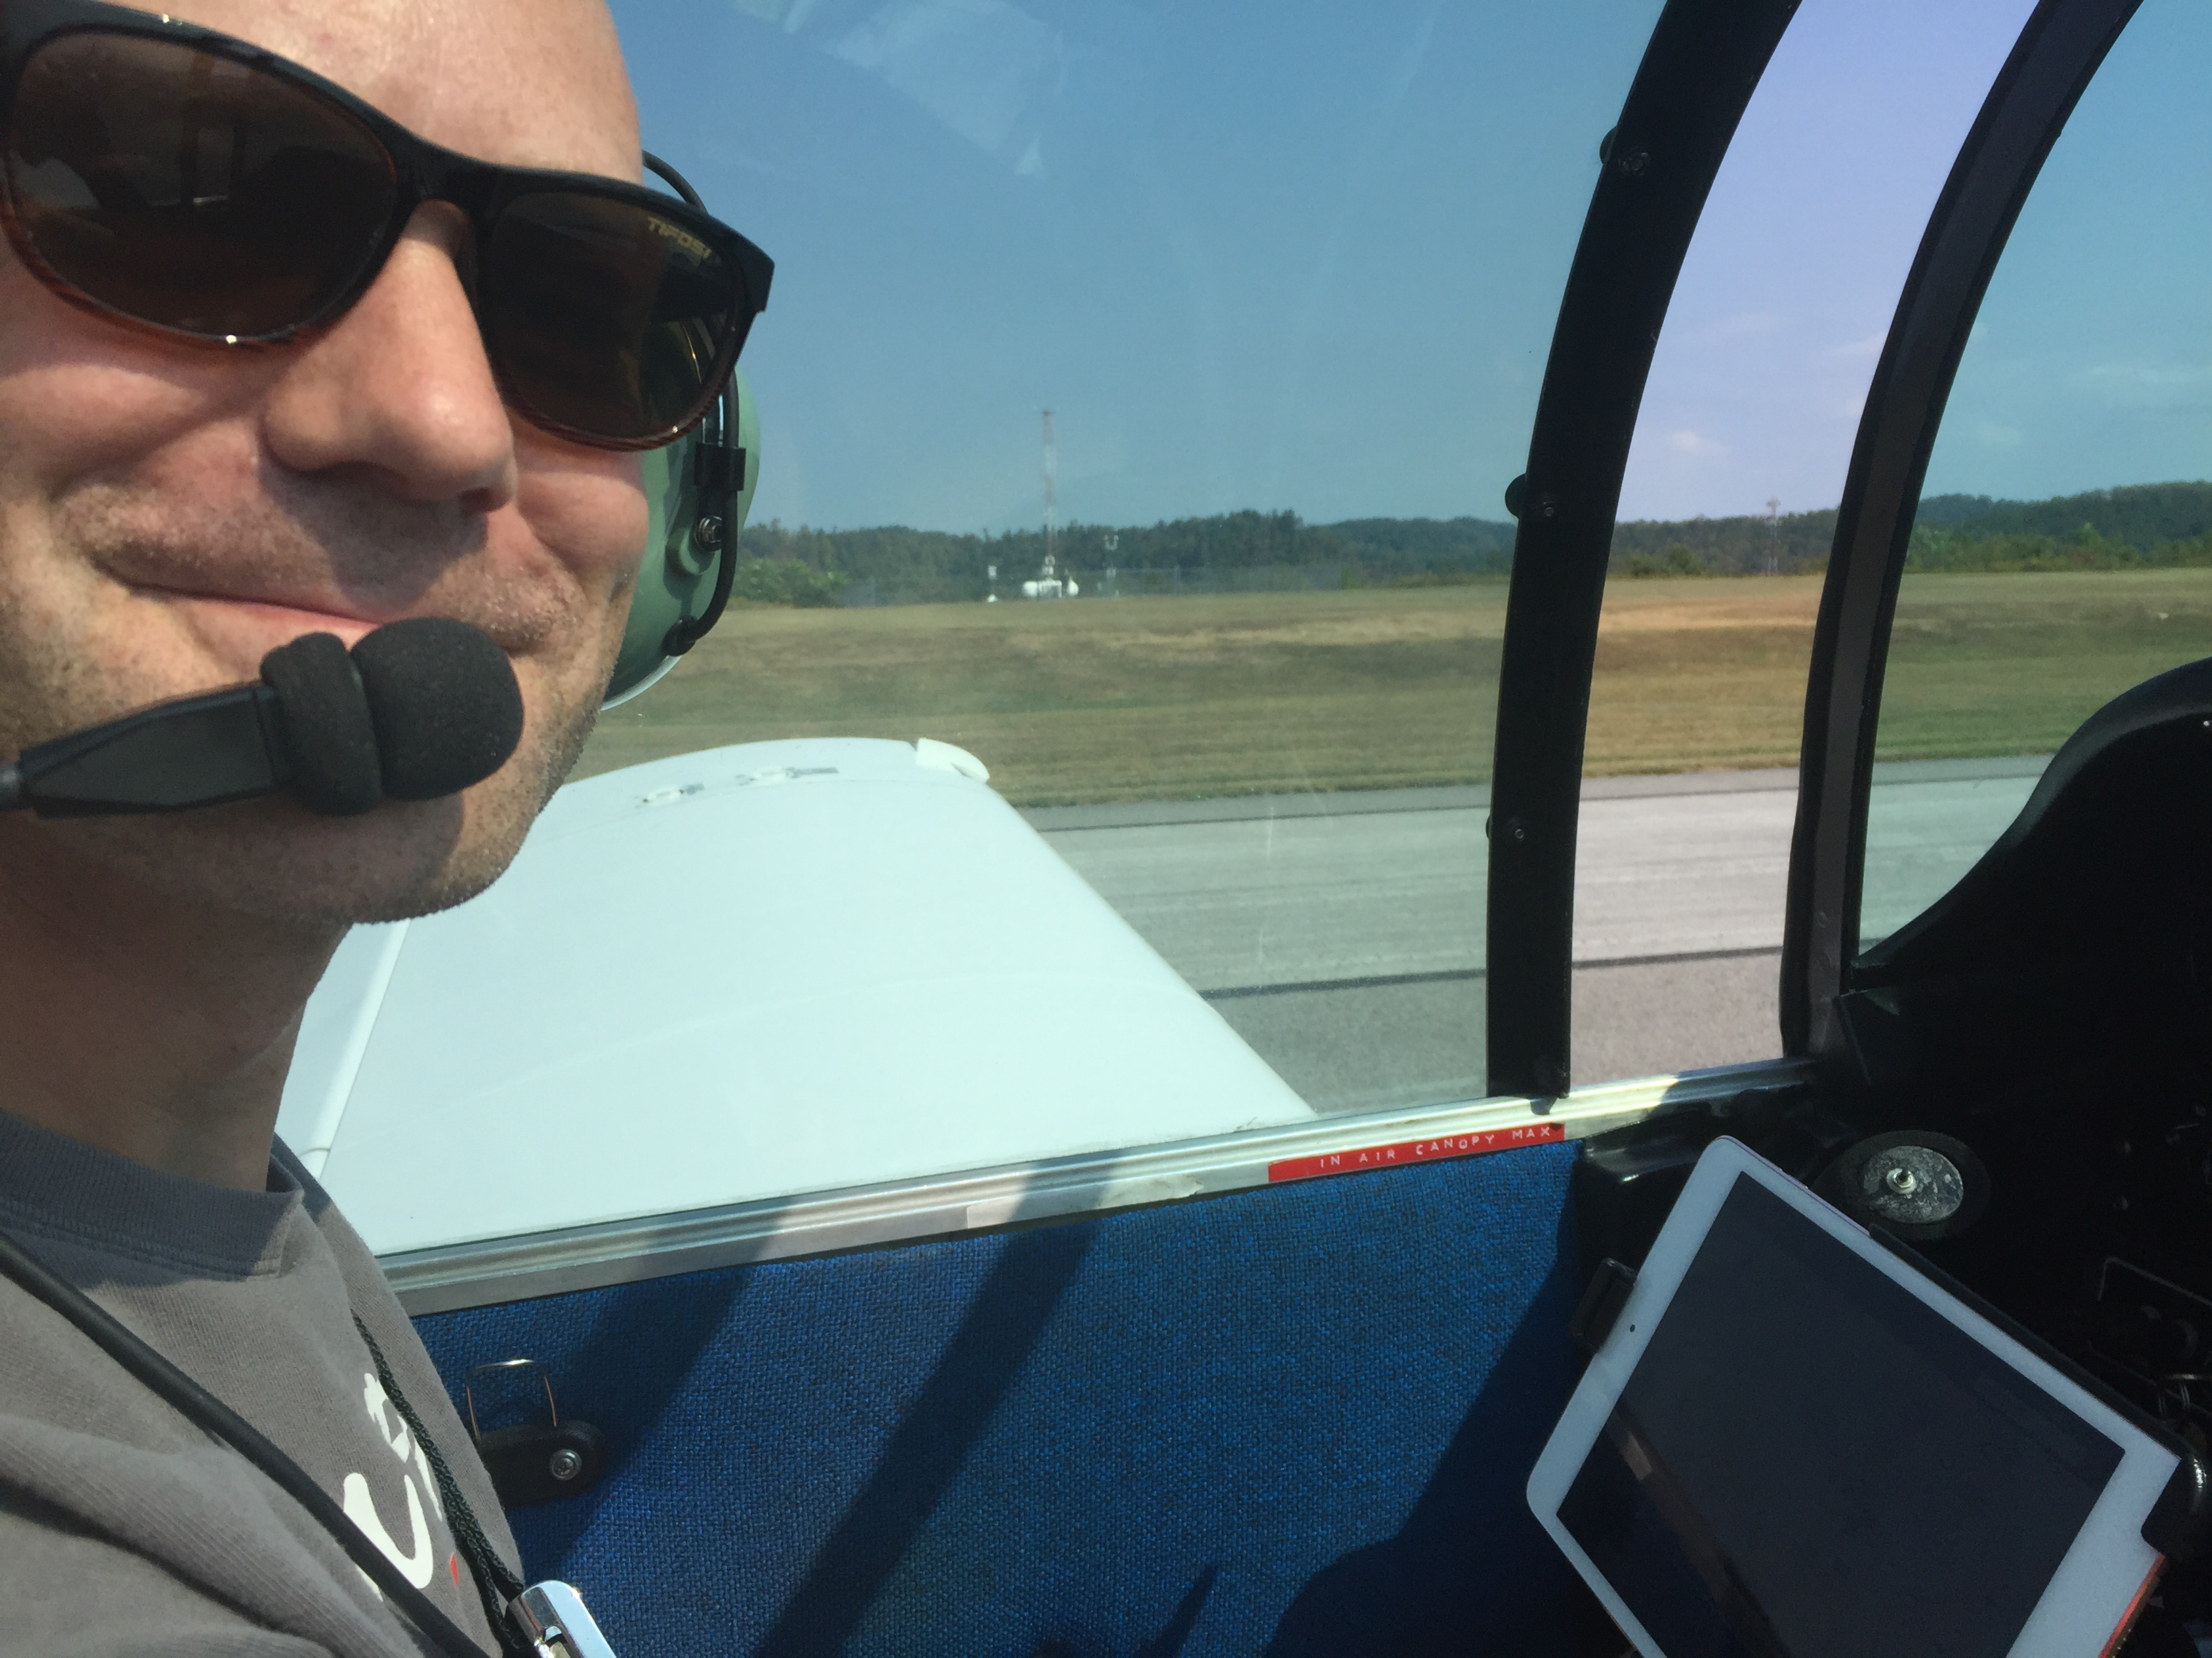
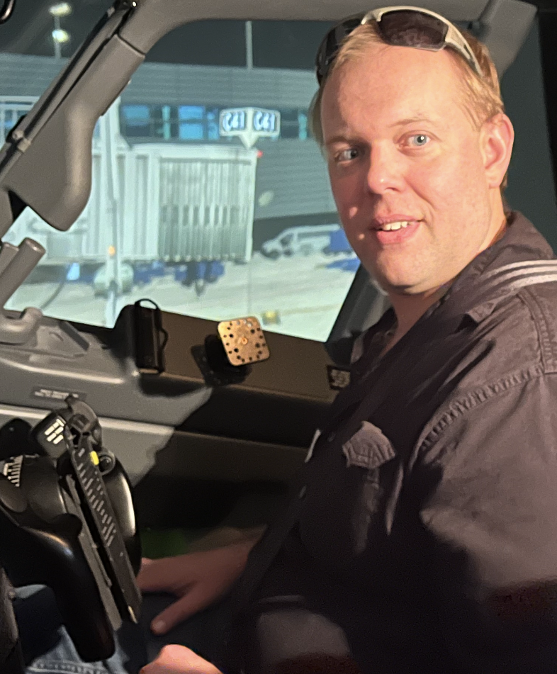
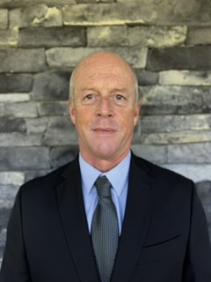
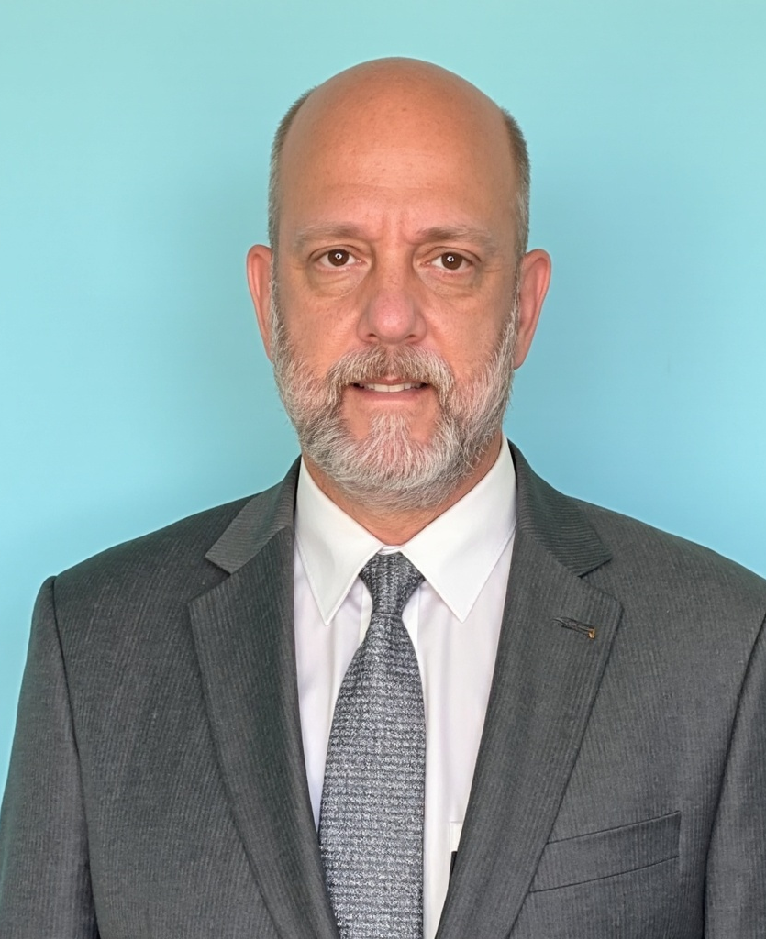
GANNON UNIVERSITY - DAHLKEMPER SCHOOL OF BUSINESS - AVIATION & BUSINESS MANAGEMENT
AVIATION CAREERS PANEL
Explore careers across flight training, corporate aviation, airport operations and aviation insurance
THURSDAY, OCTOBER 1 @ 11AM – FUNDAMENTAL FLIGHT TRAINING
PIZZA PROVIDED
Grayson Patterson
MEET THE PANELISTS
Dave “Scarecrow” Benson
AVIATION BUSINESS & OPERATIONS
FLIGHT TRAINING
Owner of North Coast Air with 20+ years in aviation and nearly 2,000 flight hours. Leads an FBO, FAA Repair Station and hangar development projects.
Co-founder and Owner of Fundamentals Flight Training and an experienced flight instructor focused on preparing students for safe, successful aviation careers.
Bryan "The Machine" Loomis
Certified Flight Instructor - Instrument
Bryan started flying in 2008 and is a very passionate flight and ground instructor. Fundamentals is proud to have him as a career CFI.
Michael R. Mang
John Danilov
CORPORATE & AIRLINE PILOT
AVIATION INSURANCE
Greenleaf Corporation Chief Pilot with 30+ years in aviation and 10,700+ flight hours. ATP, CFI and instrument instructor with corporate, charter and airline experience.
Retired after 33 years as an aviation insurance underwriter. Former AIG zonal vice president, senior aerospace underwriter and the first underwriter to earn the CAIP designation.
STUDENTS FROM ALL MAJORS ARE WELCOME
Questions or need a ride?
Contact Dr. McIntyre at mcintyre016@gannon.edu
Bring your questions and meet professionals representing four distinct aviation career paths
Notes:
Event and speaker information supplied by Dr. McIntyre. Speaker photographs supplied by the user.

